Slide 2
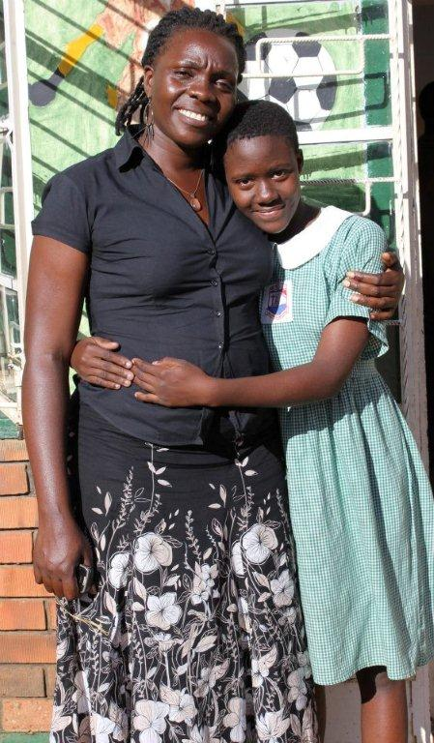
SHF Uganda was founded by Robinah Sarah, a Ugandan woman who lives outside the city of Kampala. She has spent many years walking the dirt paths of several city slums speaking with the young girls she finds in the brothels.
The Fanwood Scotch Plains Rotary and Scotch Plains Fanwood has vowed to assist the young girls of Kampala, Uganda and the home of “Set Her Free”.

Slide 3
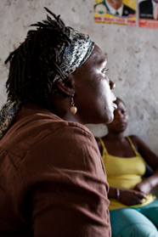
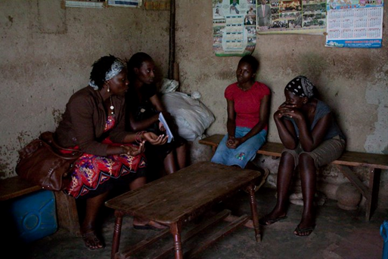
Reaching out into the slums
We all know it is wrong to exploit our youth and we will continue to join with our partners supporting these girls and believing we can put an end to this horrible reality

Slide 4
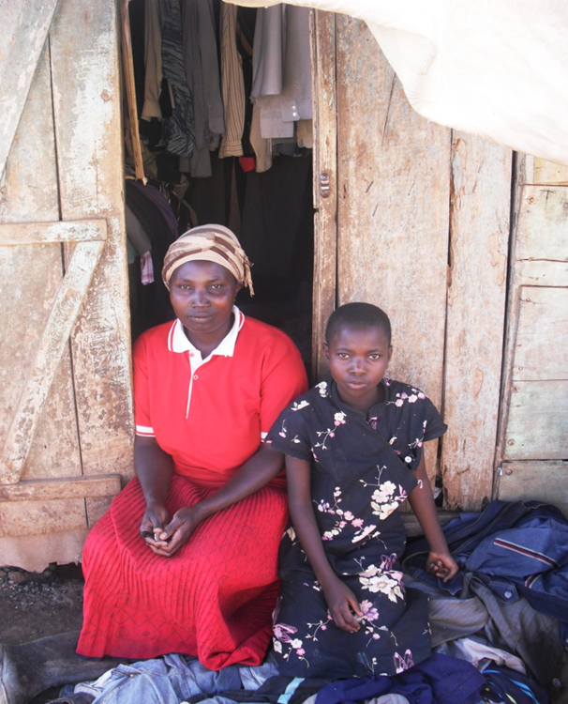
MARIA

Slide 5
JUSTINE
Justine came to Set Her Free when she was 17 years old. Her parents had forced her to drop out of school because they could not afford her fees.

Slide 6
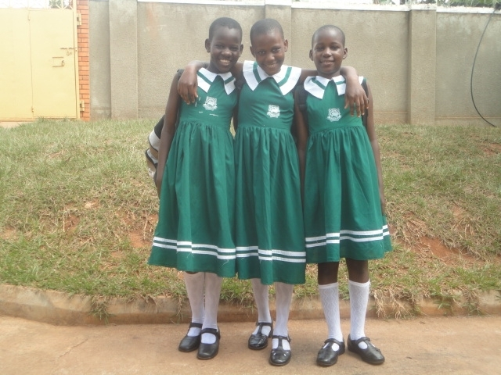
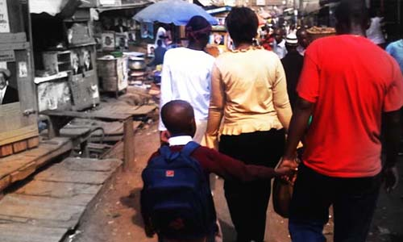
Set Her Free Program offers:
Basic Need
Medical and physiological Care
Formal Education
Vocational Skills Training and Apprenticeships
Entrepreneurial skills
Mentorship
Leadership Training
Religious Discipleship
The Arts
Athletics
Community Outreach
Follow Up Care

Slide 7
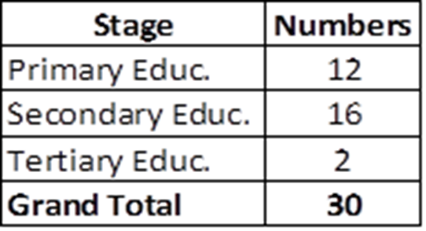

Slide 8
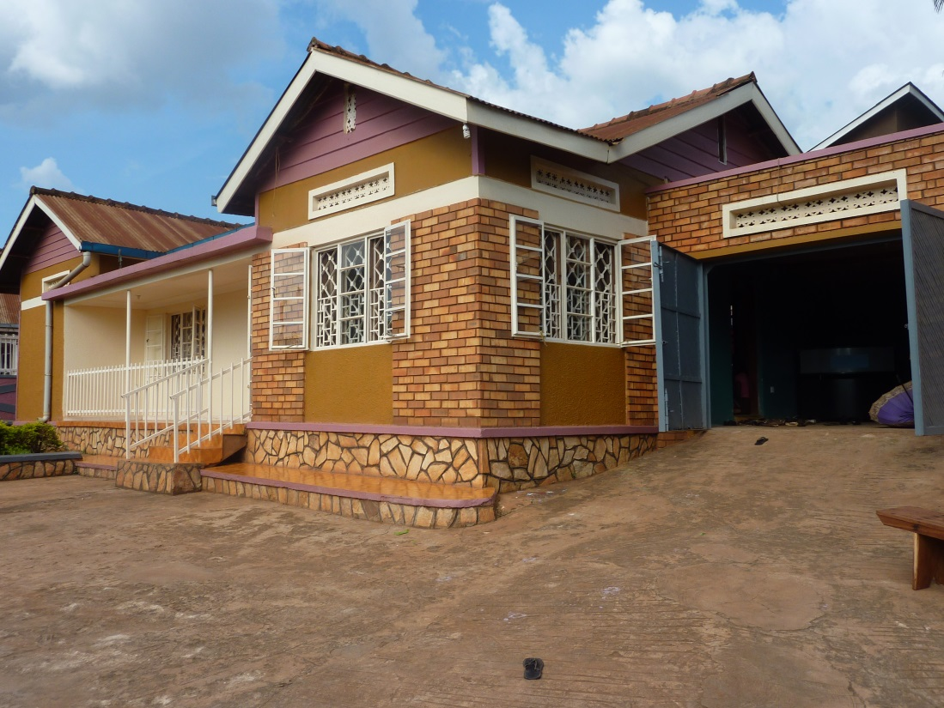
Set Her Free Homes
Keti
Bwaise

Slide 10
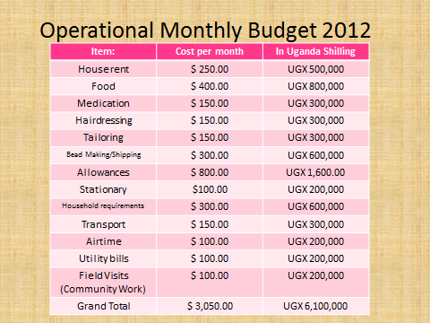

Slide 11
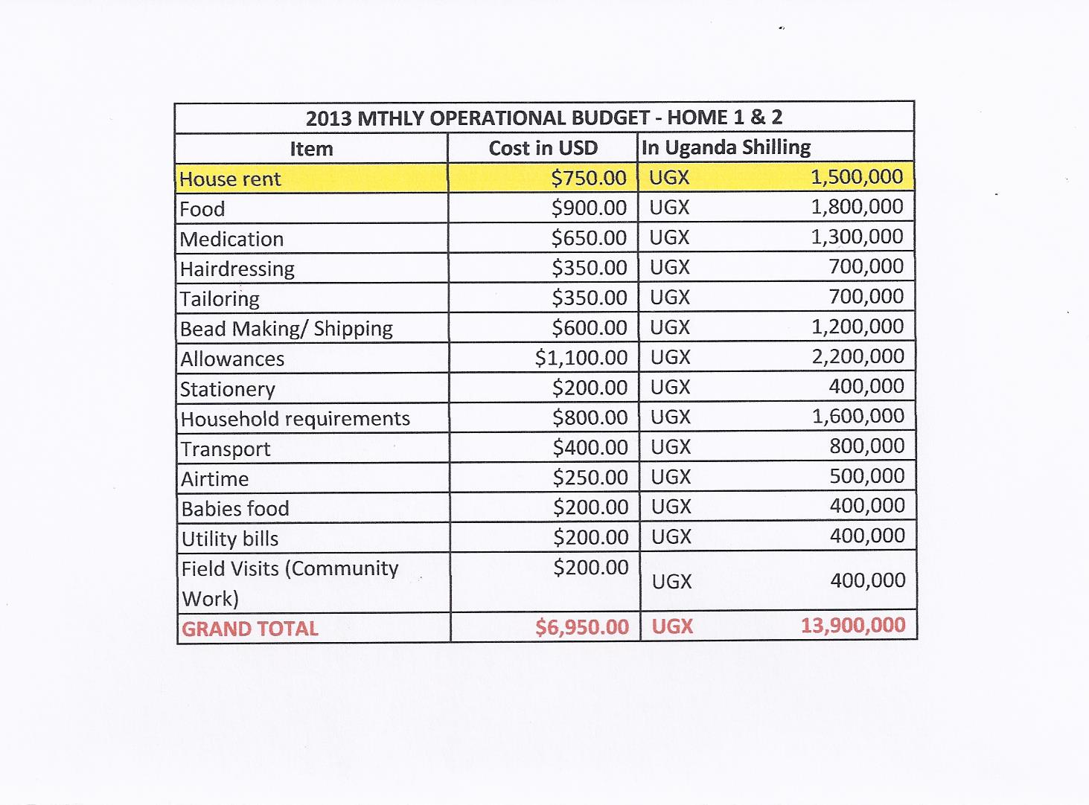

Slide 12
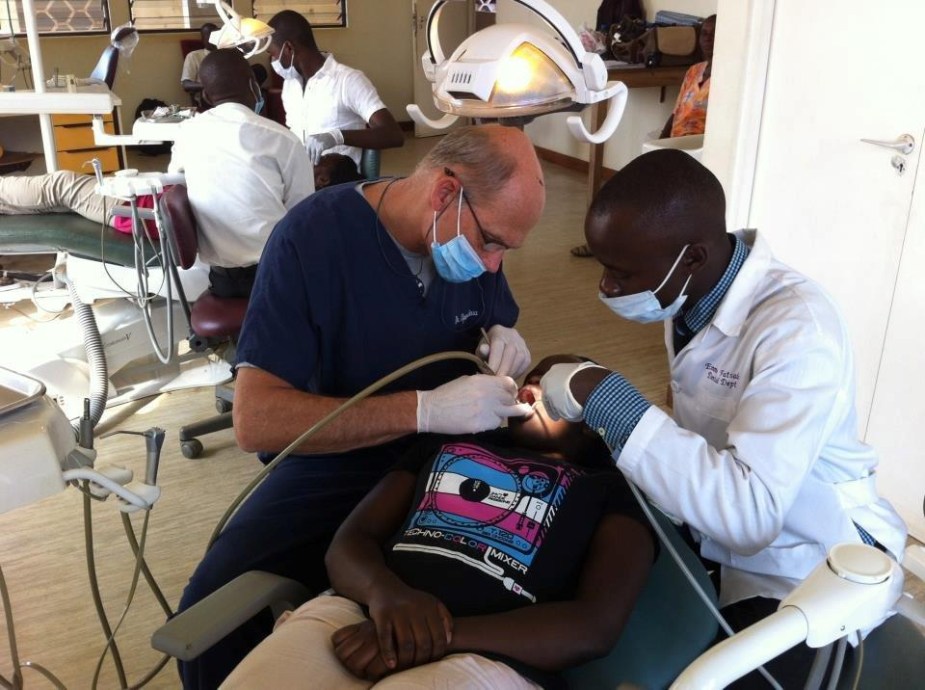
Volunteers go to Kampala

Slide 13
Vocational Programs
Hairdressing
Sewing

Slide 14
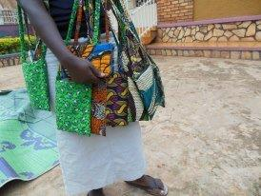
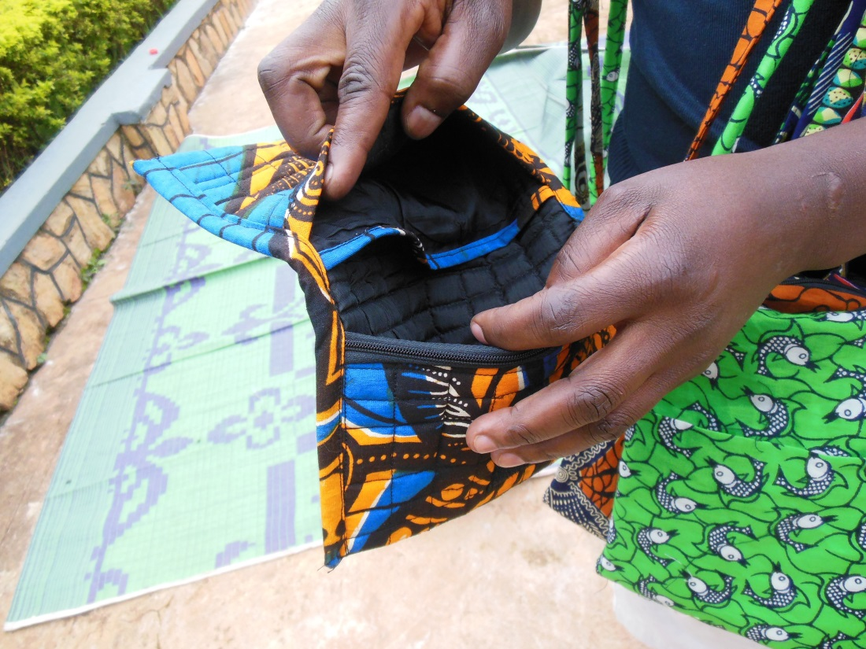
In the sewing program the girls learn how to sew and repair clothing. After graduation many of our girls go back to their villages and start up a small business or find work in a shop.

Slide 15
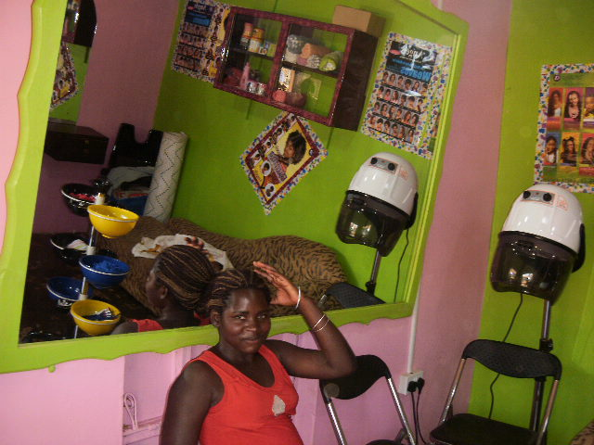
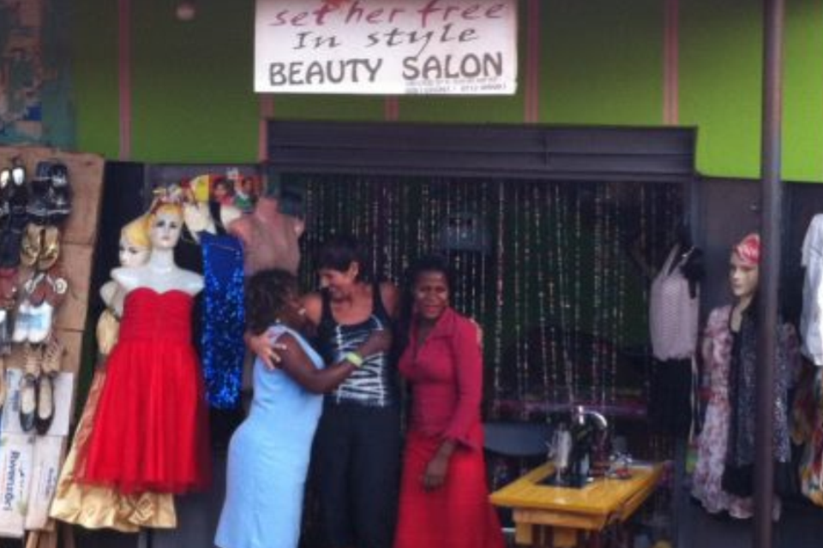
Congratulations to our 1st Graduating class of 2012 for opening a beauty salon in Kampala! The shop is a big success.

Slide 16
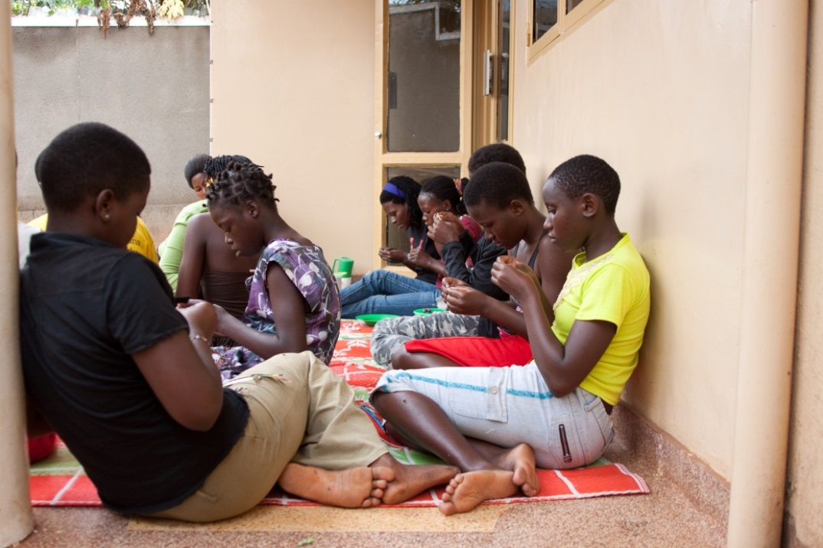
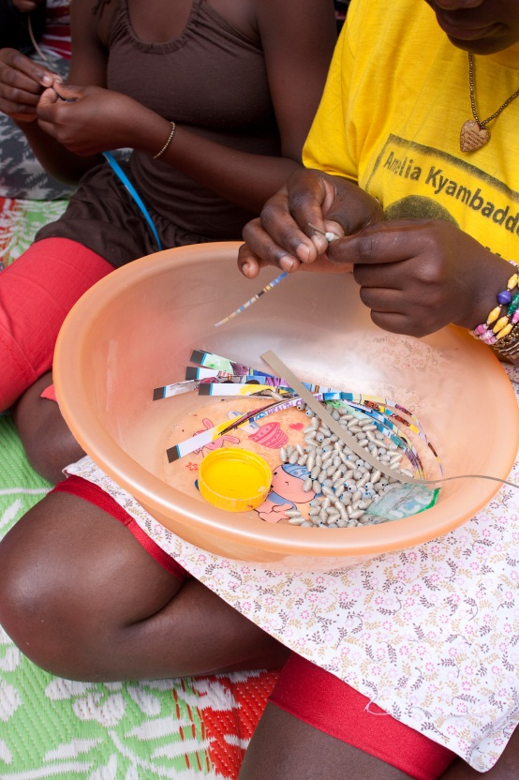
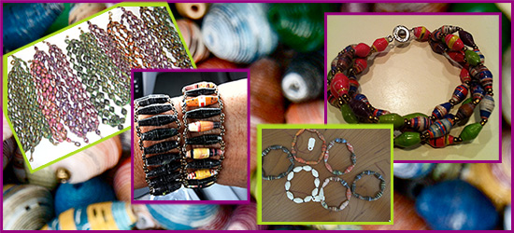

Slide 17
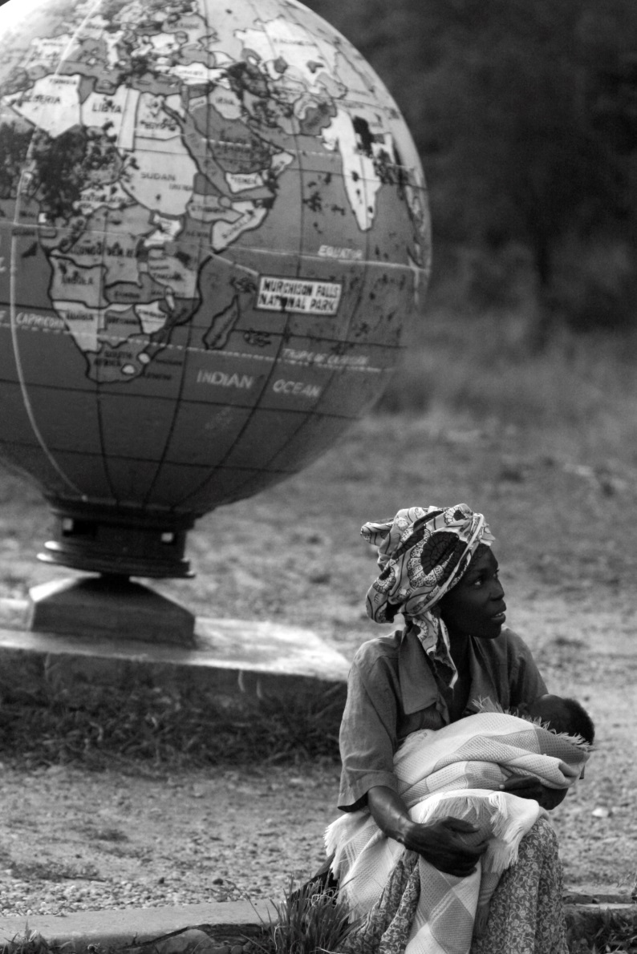
Economic and community Development
“Educating women and girls has the most optimistic, positive effects on families, communities and economies worldwide. To see it is to know it.”
Meryl Streep

Slide 18
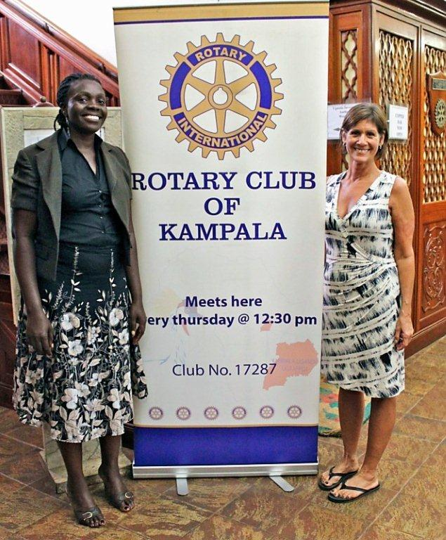
Our Partners for the cause:
Set Her Free
Rotary Club of Fanwood Scotch Plains
Rotary District 7510
Rotary Club of Kampala
Naguru Teenage Center
Segal Foundation

Slide 19
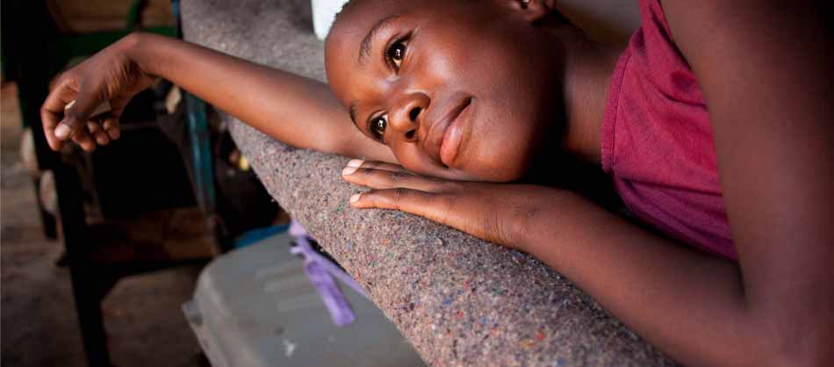
VISION
By the utilization of tools given, our goal is for these women to experience a positive transformation, to become self-worthy and to lead a sustainable way of life.
Empowering Young Women of Uganda

Slide 20
.
Our Hopes and Dreams for the Future:

Slide 21
DONATIONS
100% OF YOUR DONATIONS GOES DIRECTLY TO THE CAUSE.
All Donations can be sent to FSP Rotary side-marked: Beads of Hope donation. FSP Rotary, PO Box 426, Fanwood, NJ 07023. Any questions or comments please write to : Kiran@designalternativesllc.com. Or call 908-403-1985

